Slide 1
AR Motoworks Corp
AR Motowork corp is a blog like website where the company post their variety of works and the users can see the company’s works and if they want to work with them they can contact them and also they can leave their reviews.the users can also view the products that the company offers.

Slide 2
Features used
JSON-Server-Auth
Nginx
Pipes
Form handling
Lazy loading of modules
Routing, Child routing and params
HTTPClient and Observables
Angular Material Controls

Slide 3
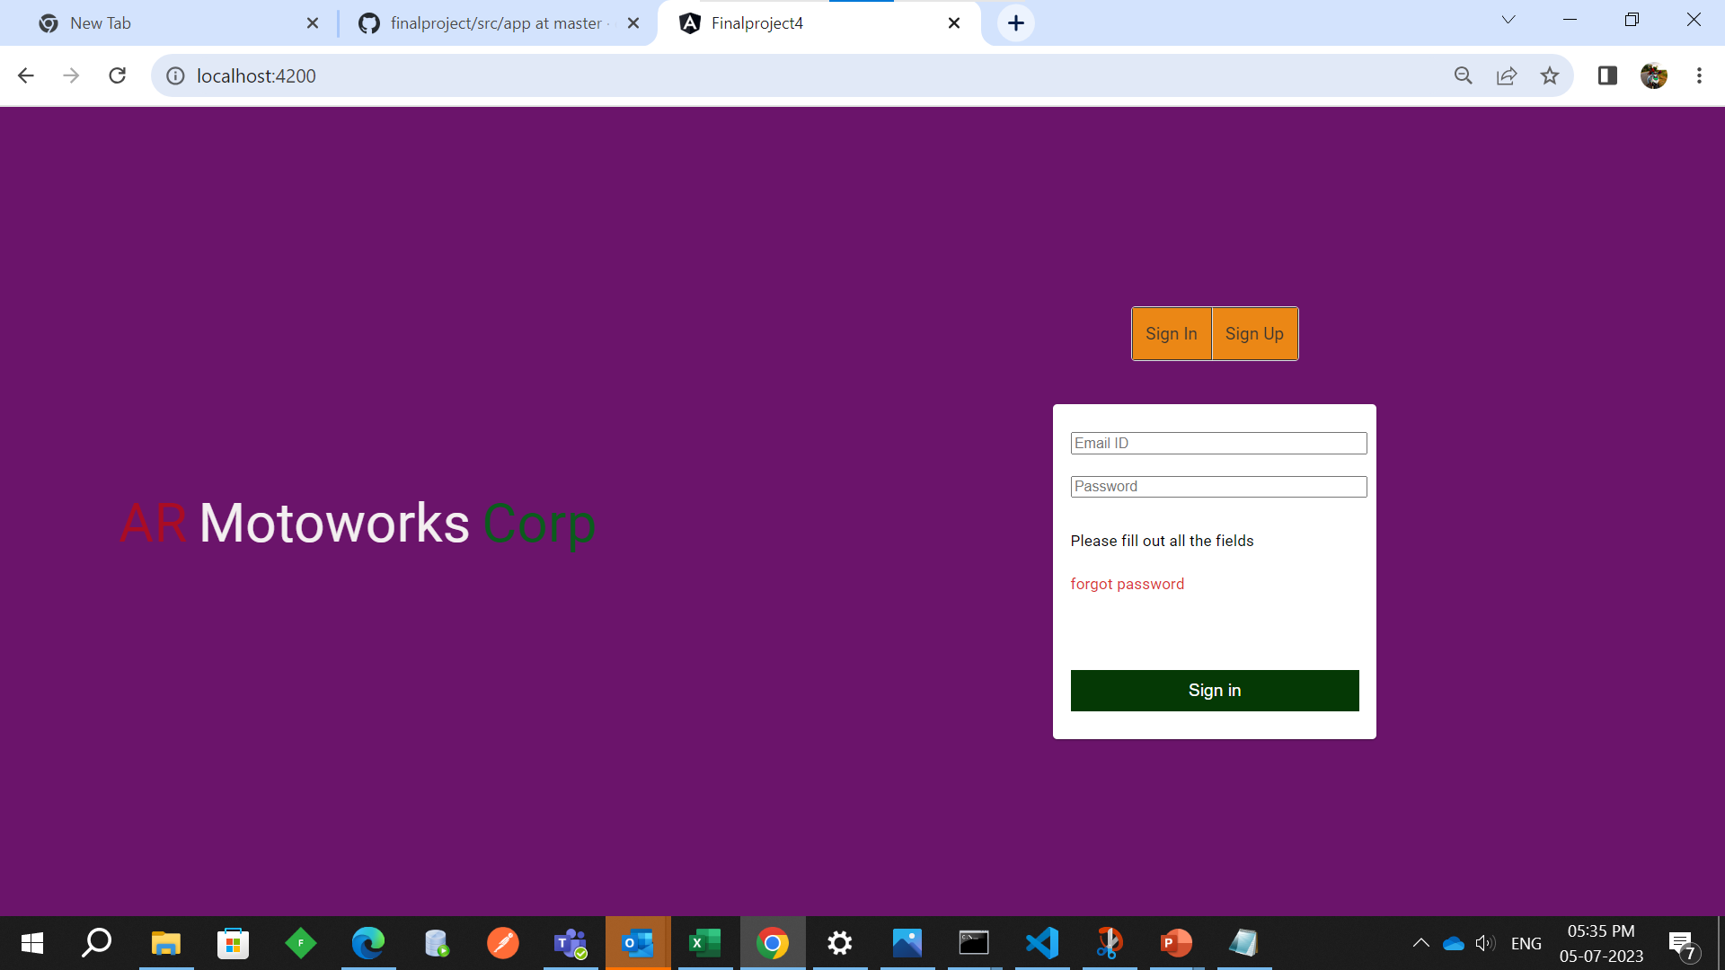
Login page

Slide 4
User side

Slide 5
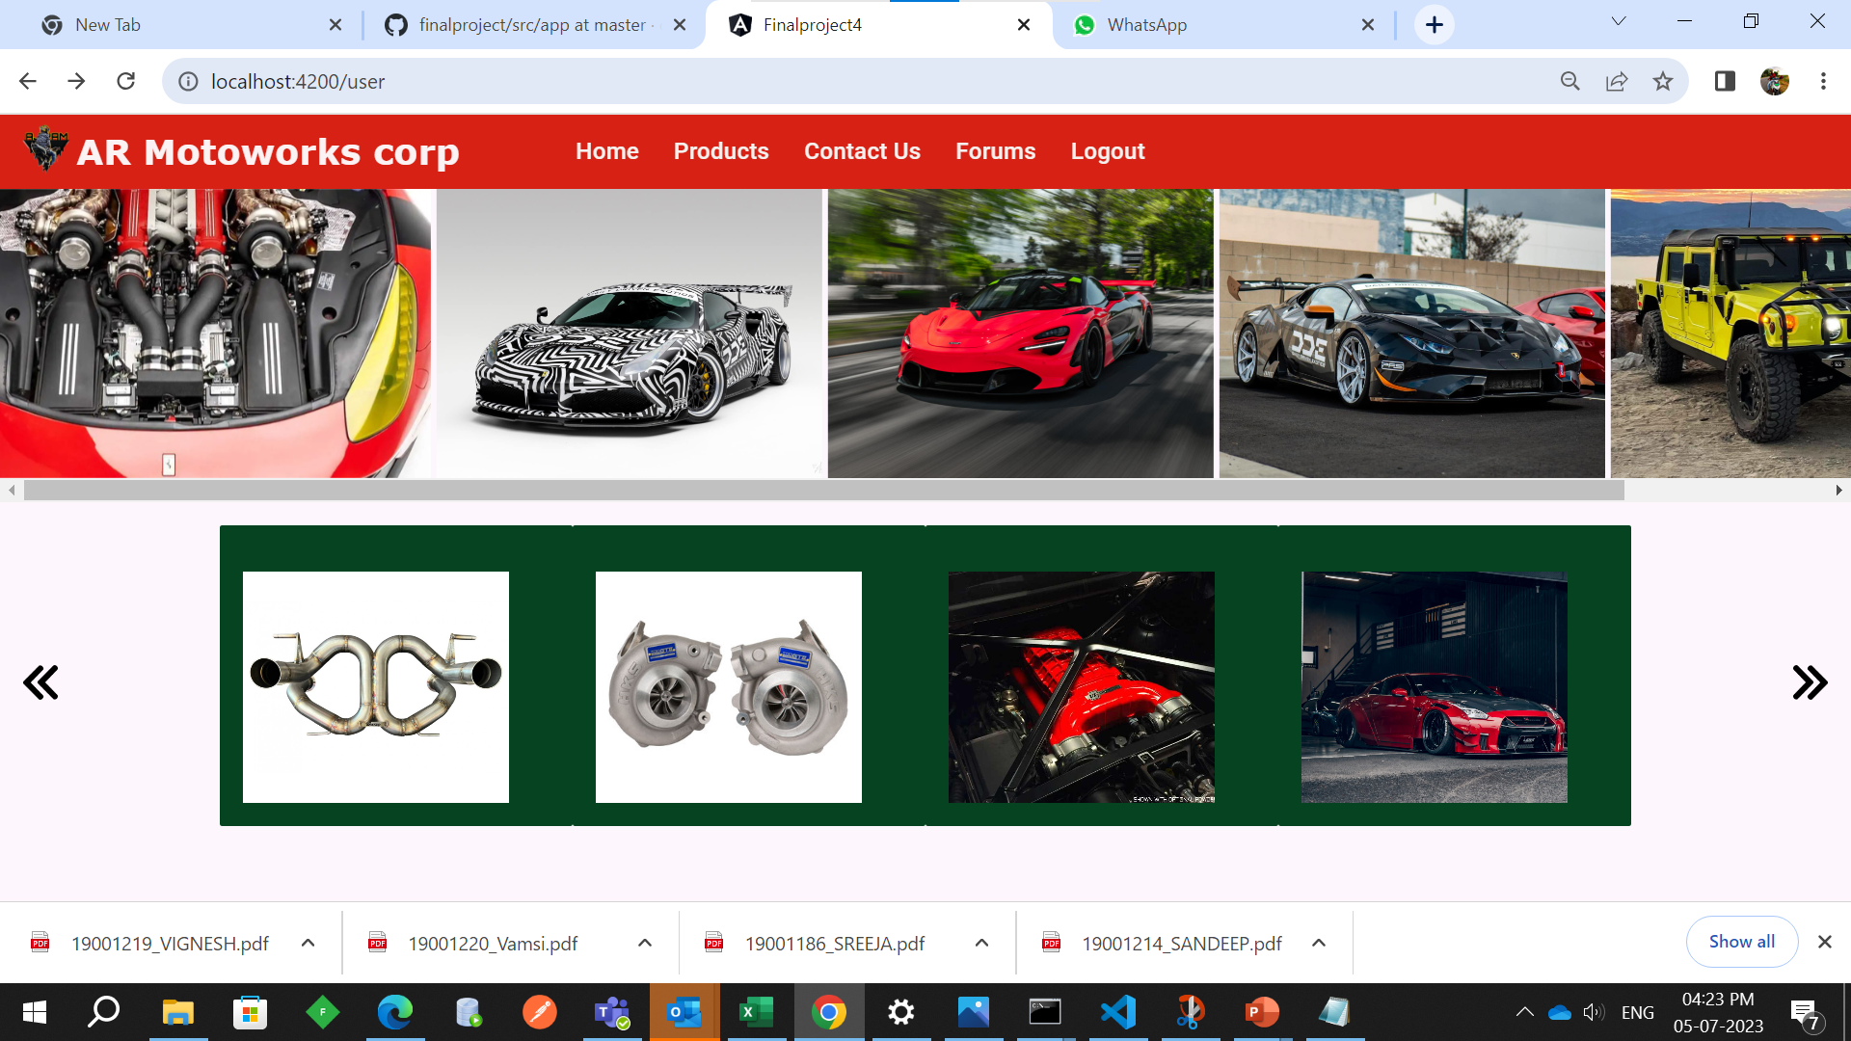
Home Page

Slide 6
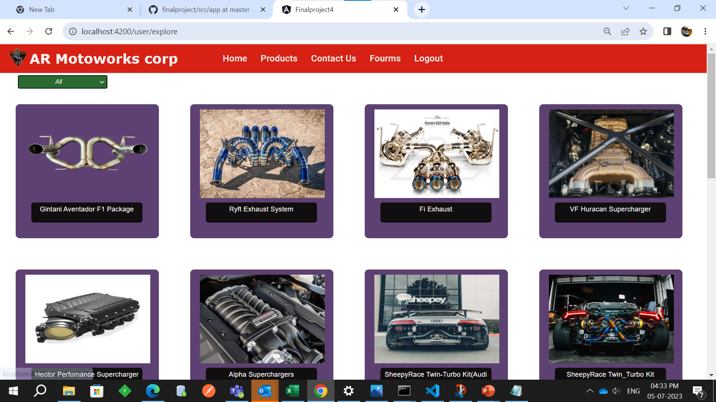
Products

Slide 7
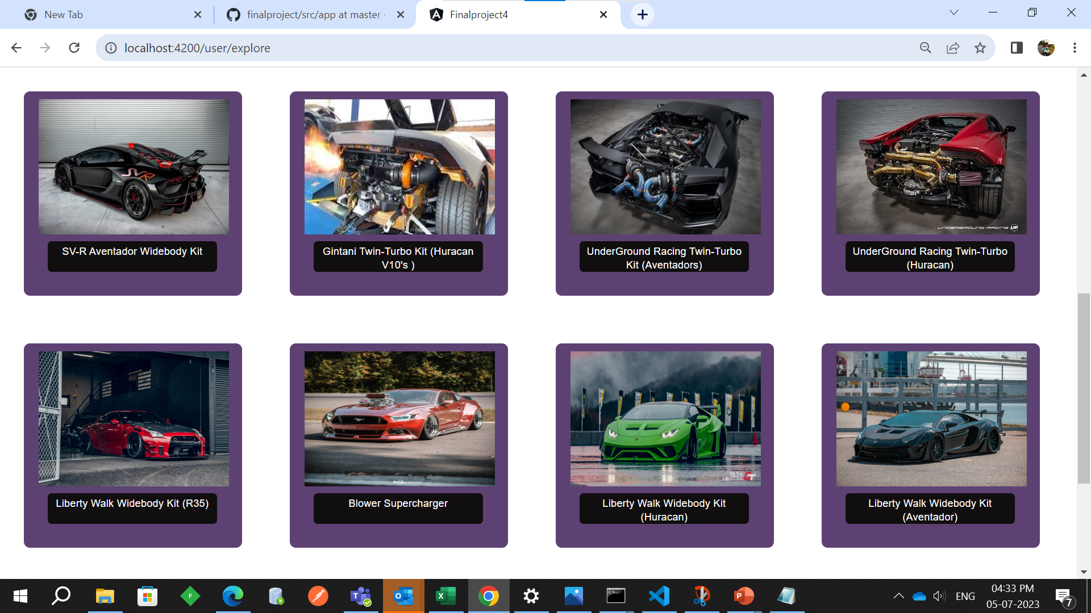

Slide 8
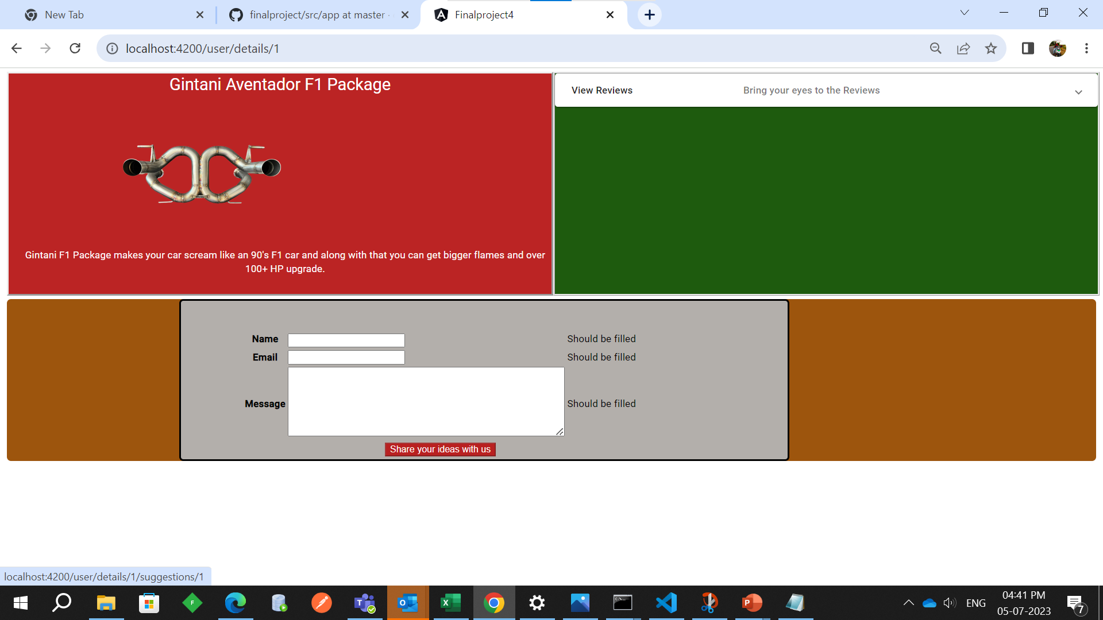
Product detail

Slide 9
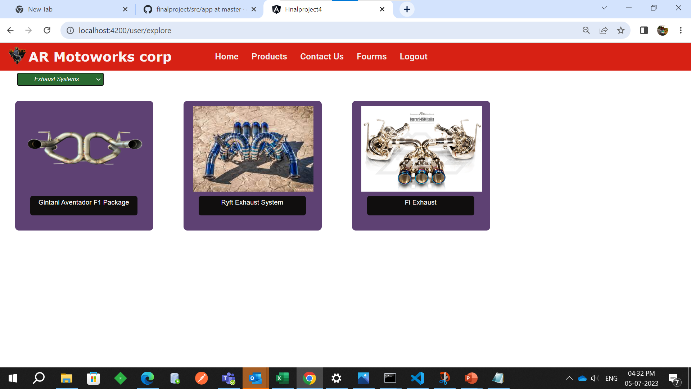
Filtering through products

Slide 10
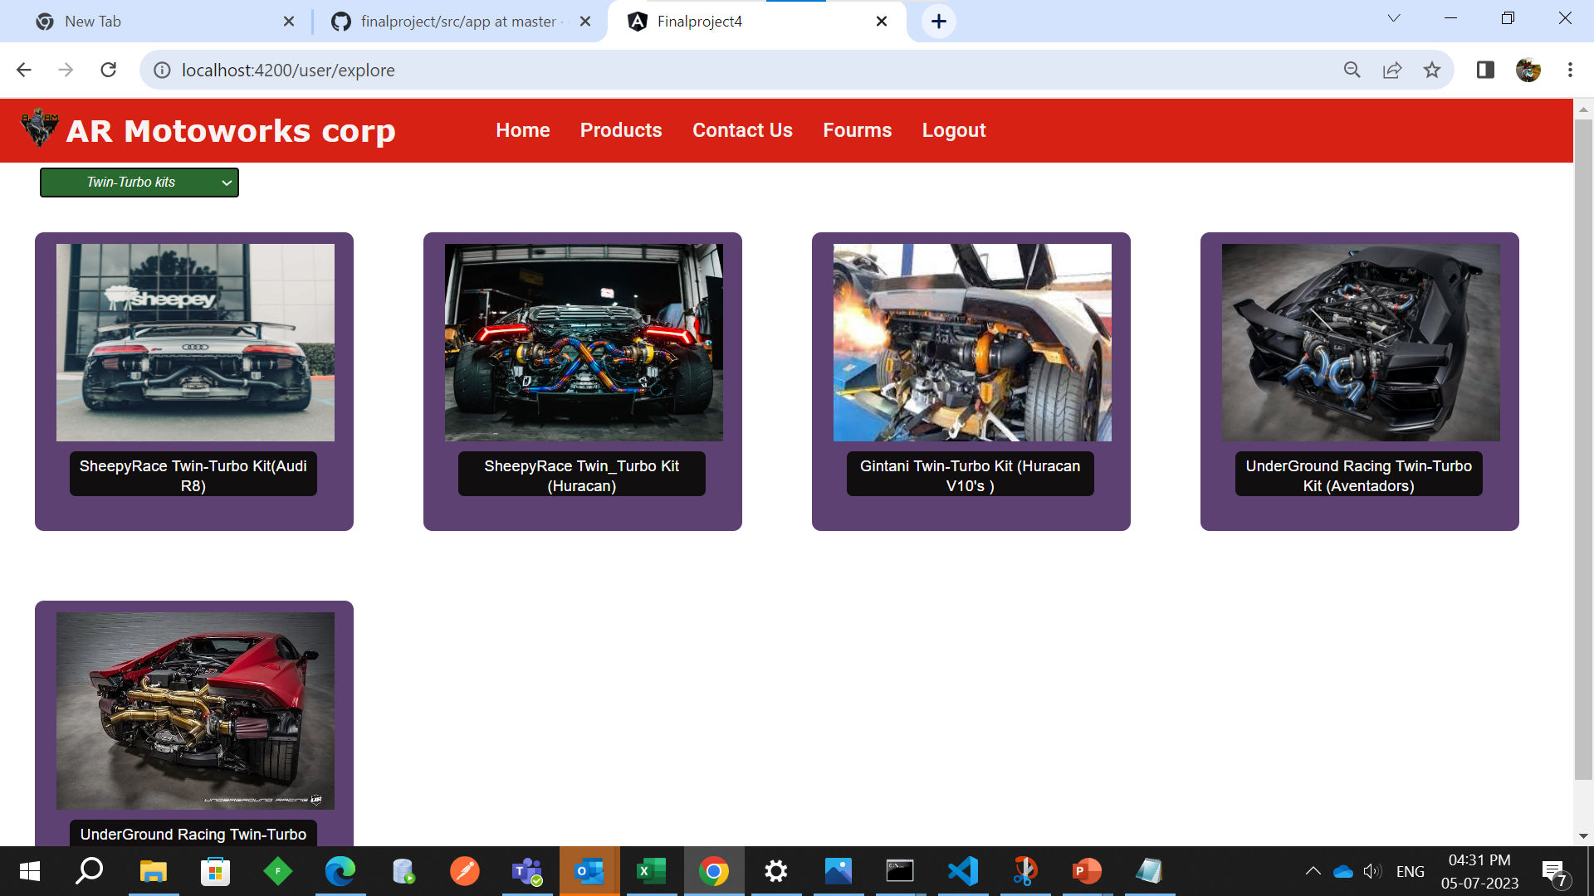

Slide 11
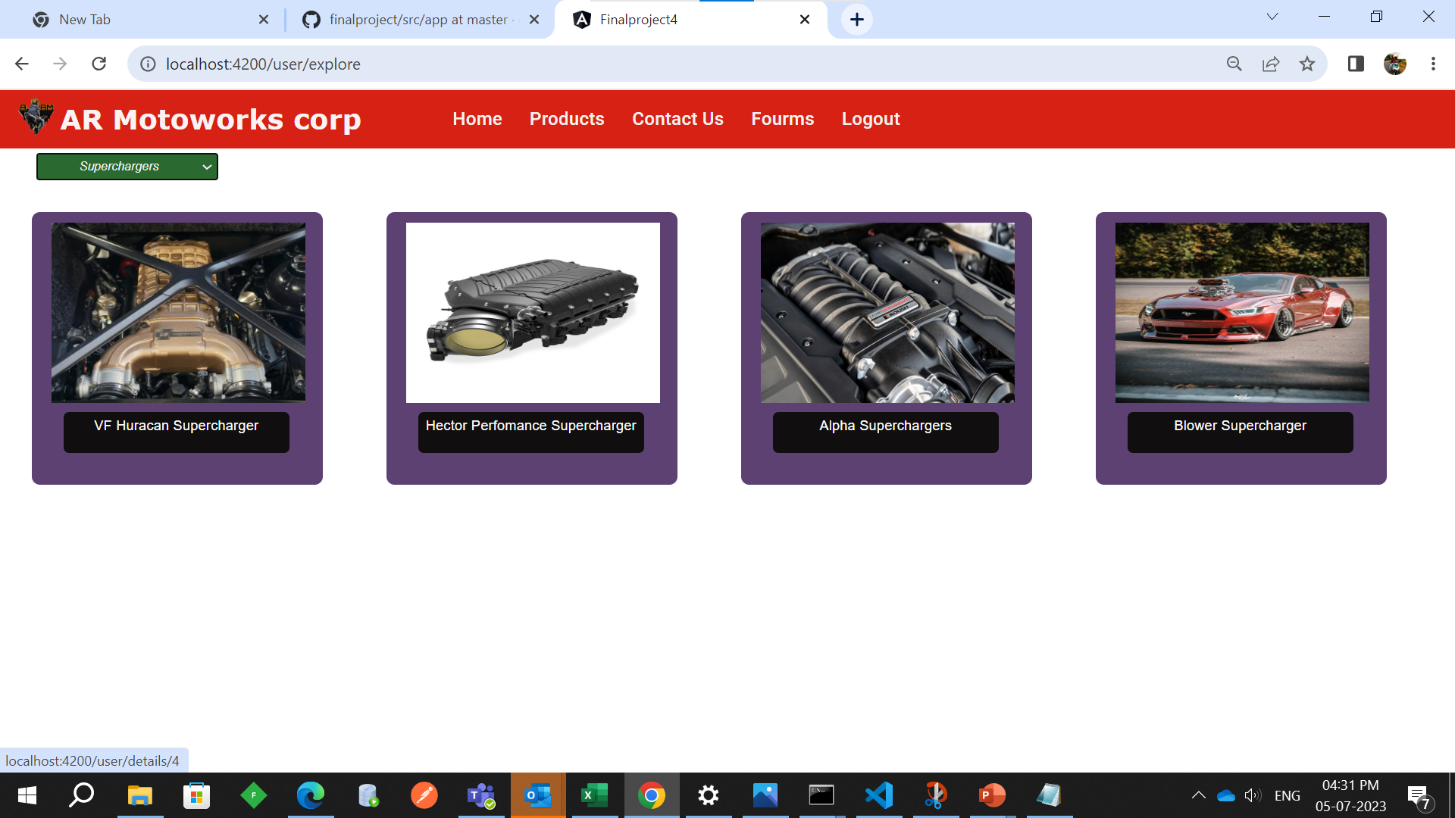

Slide 12
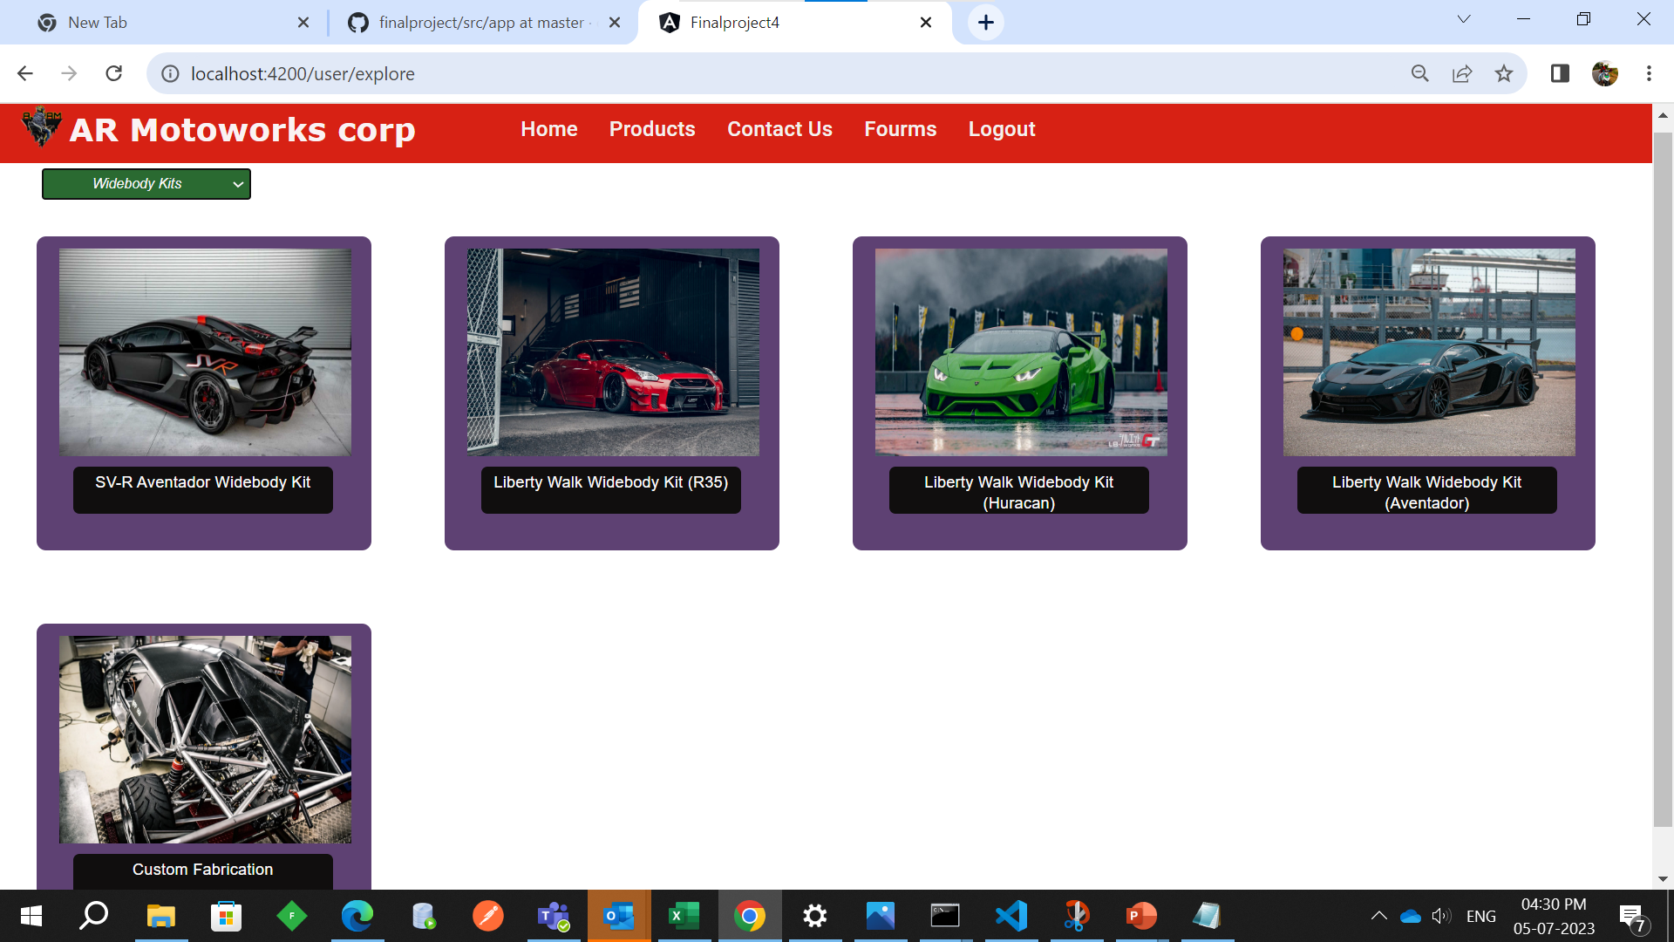

Slide 13
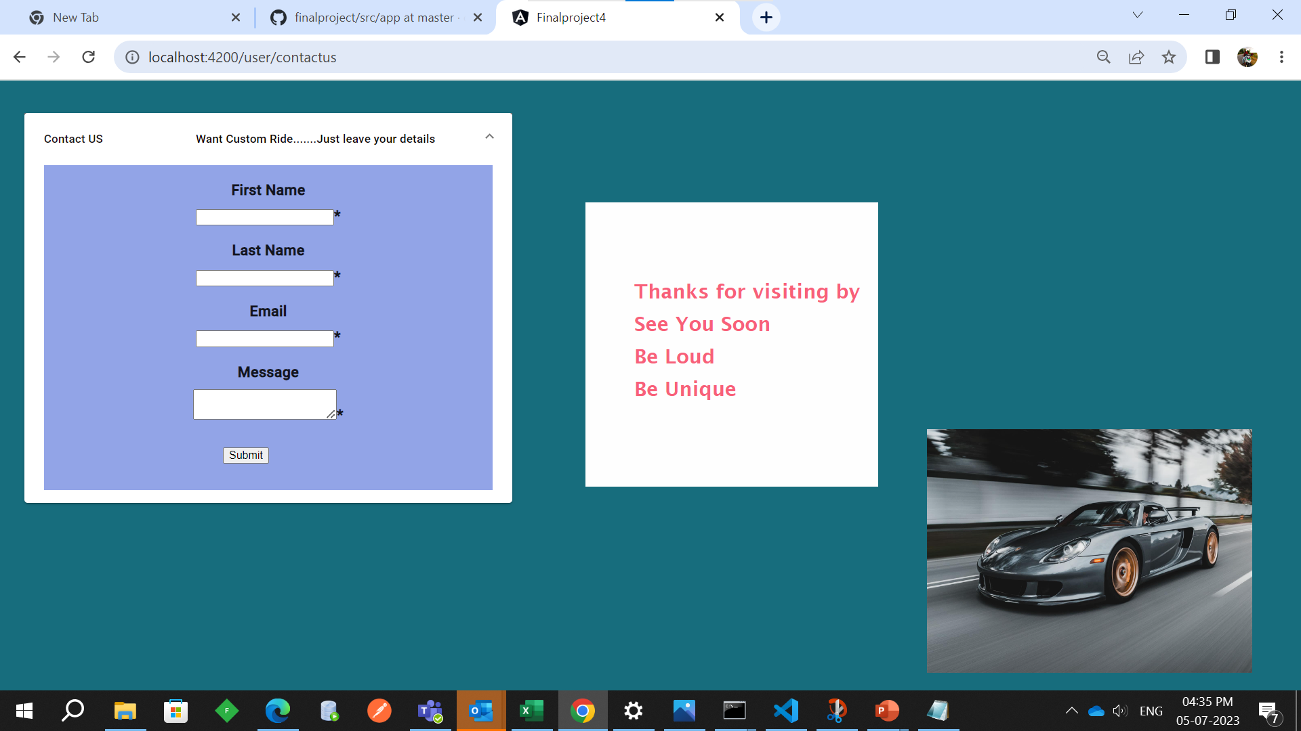
Contact us

Slide 14
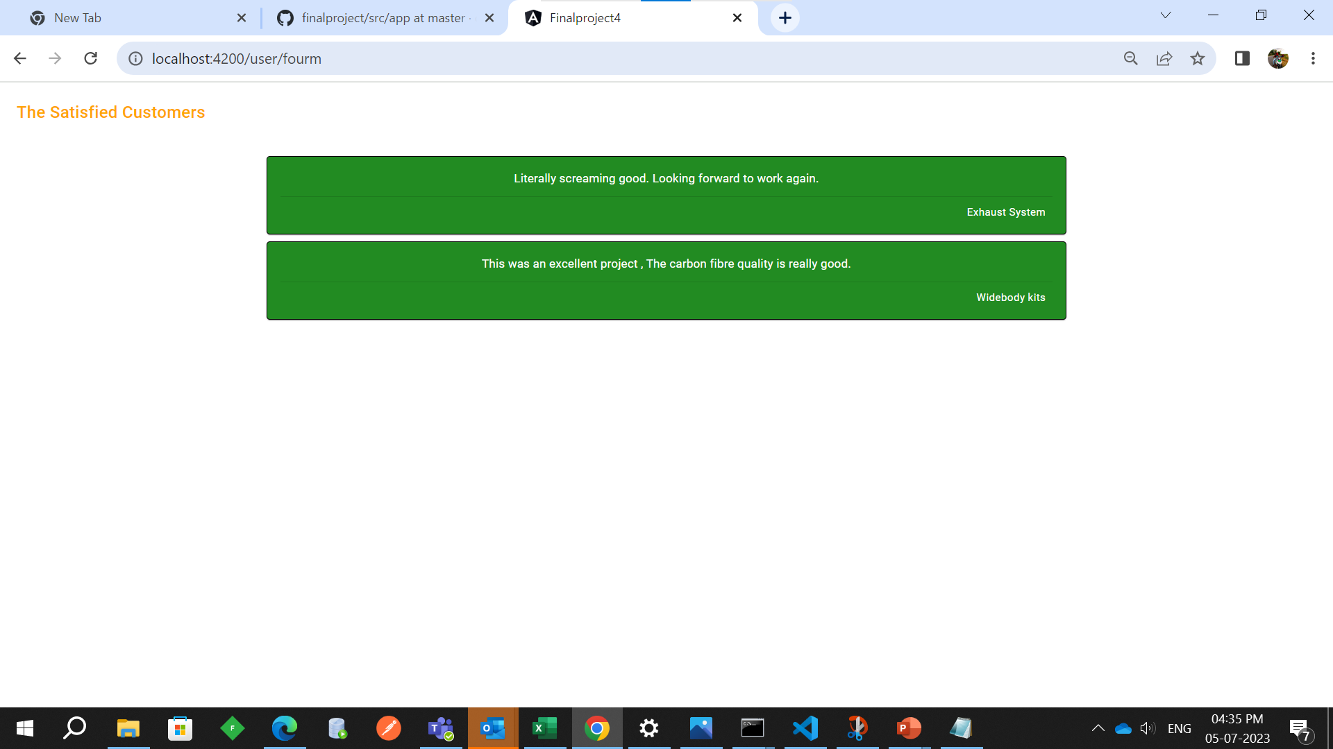
Forums

Slide 15
Admin side

Slide 16
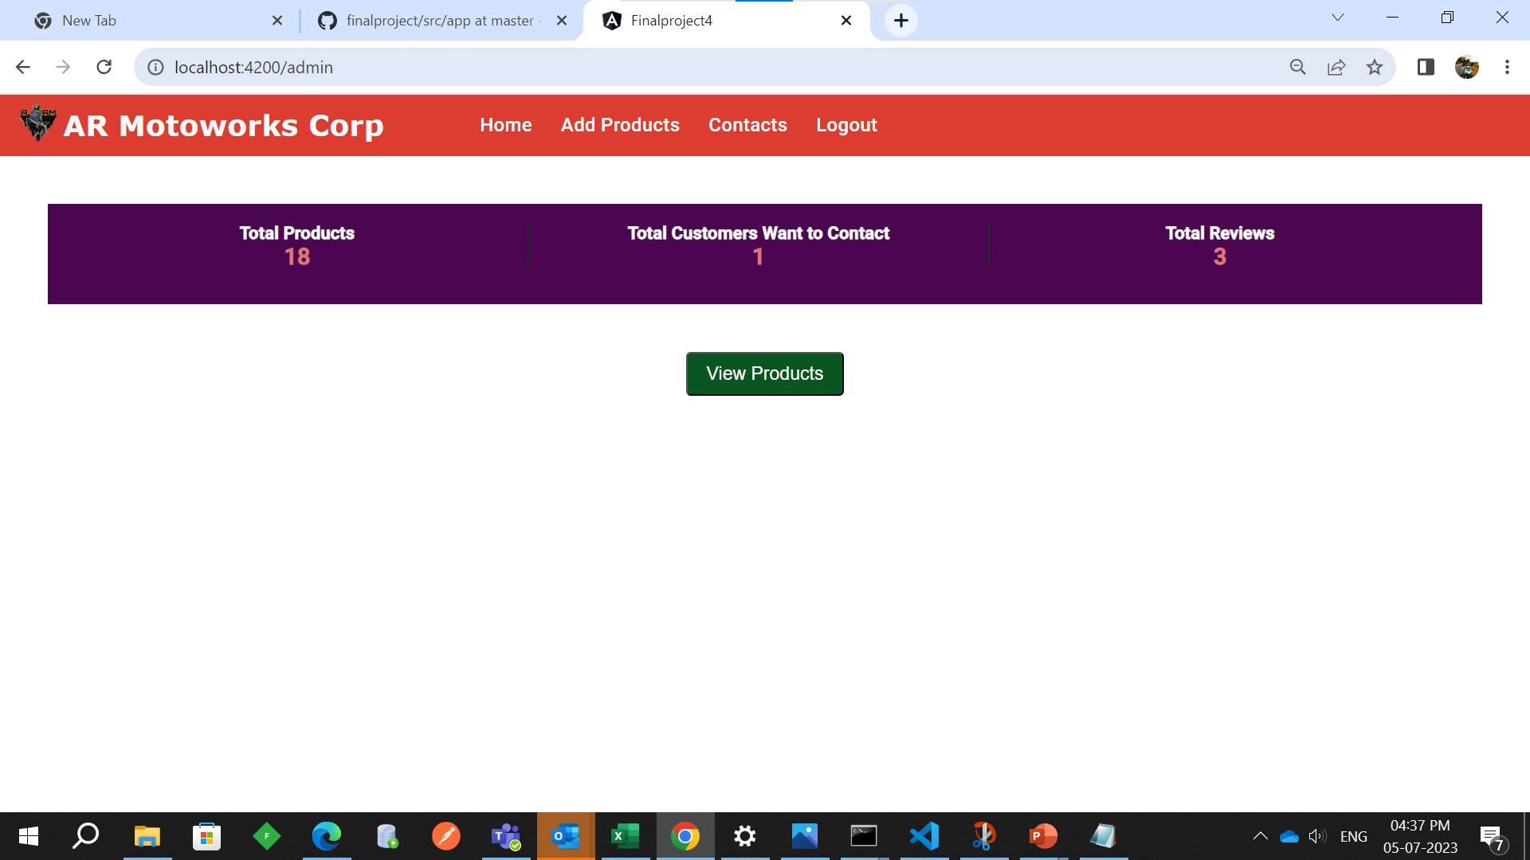
home page

Slide 17
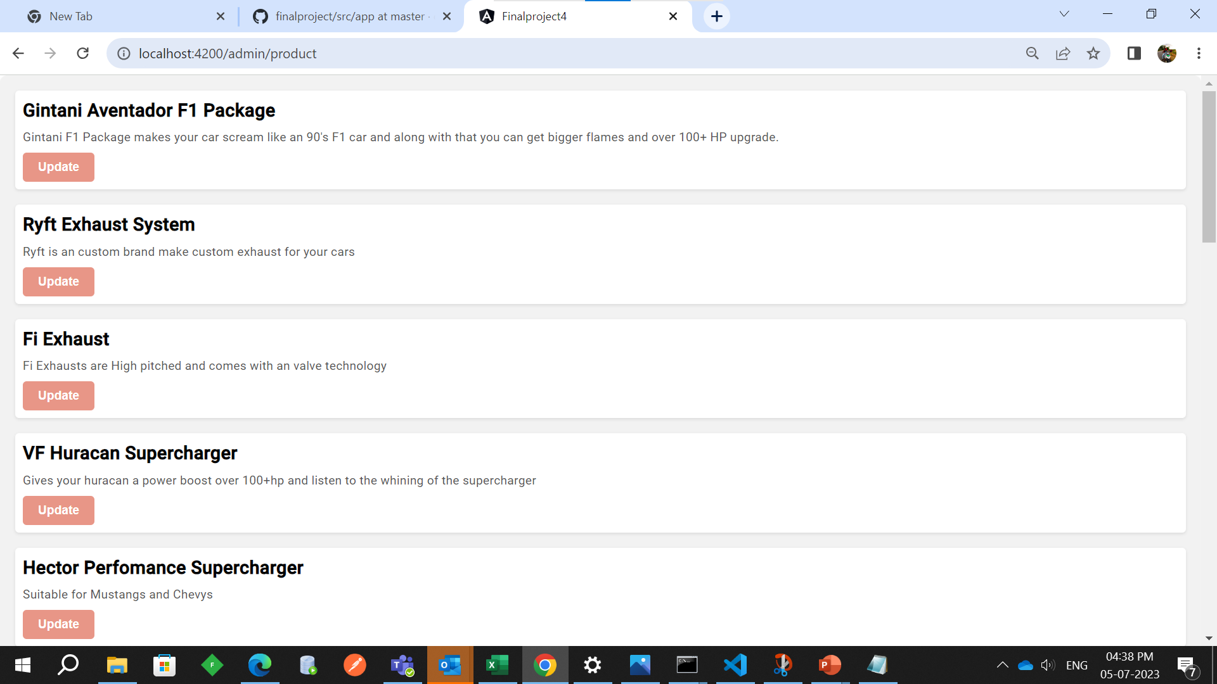
View products

Slide 18
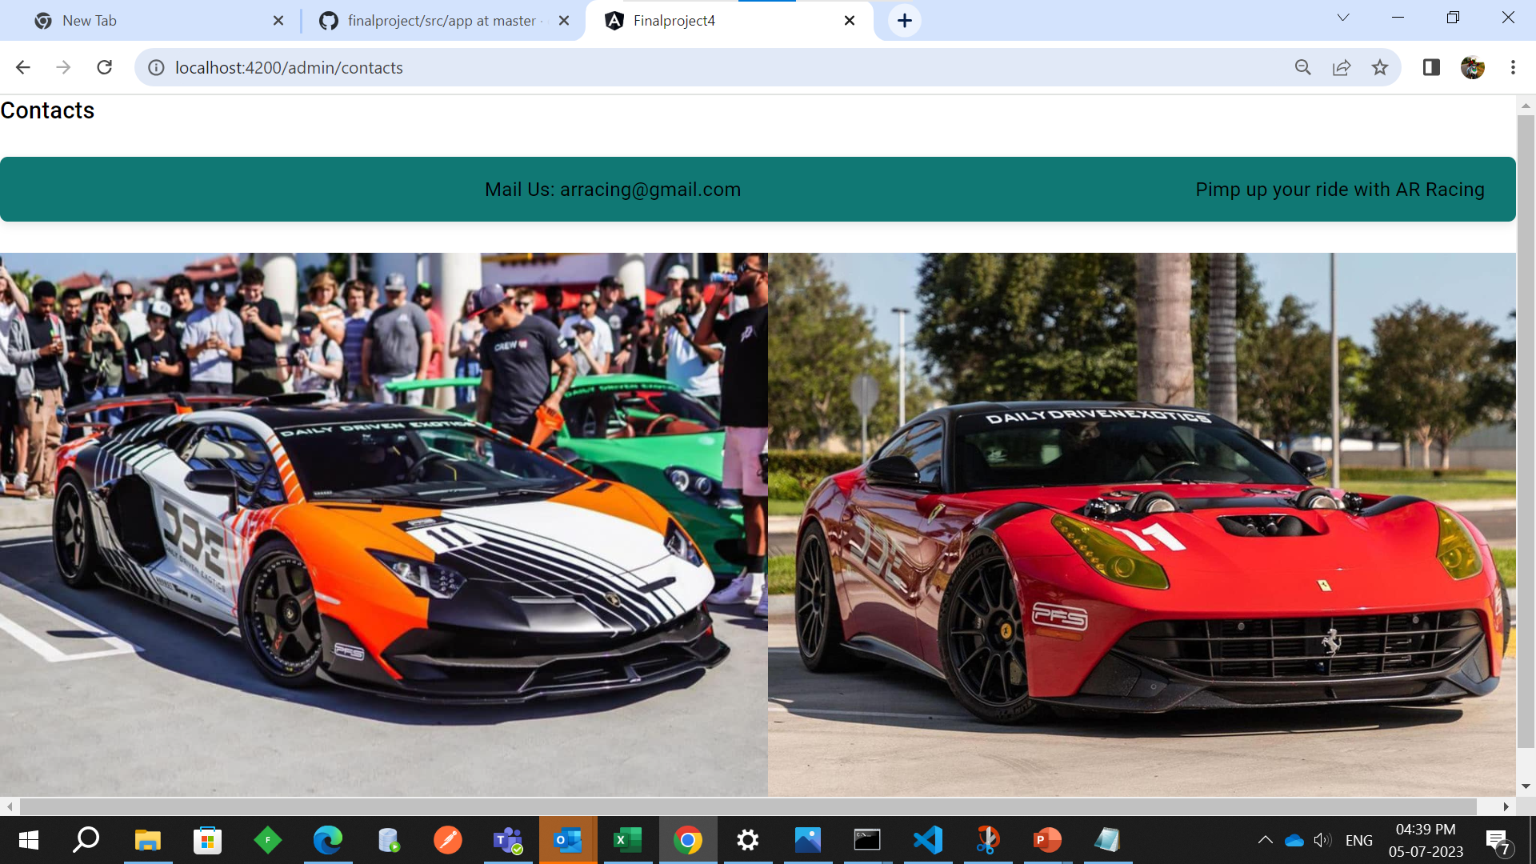
Contact

Slide 19
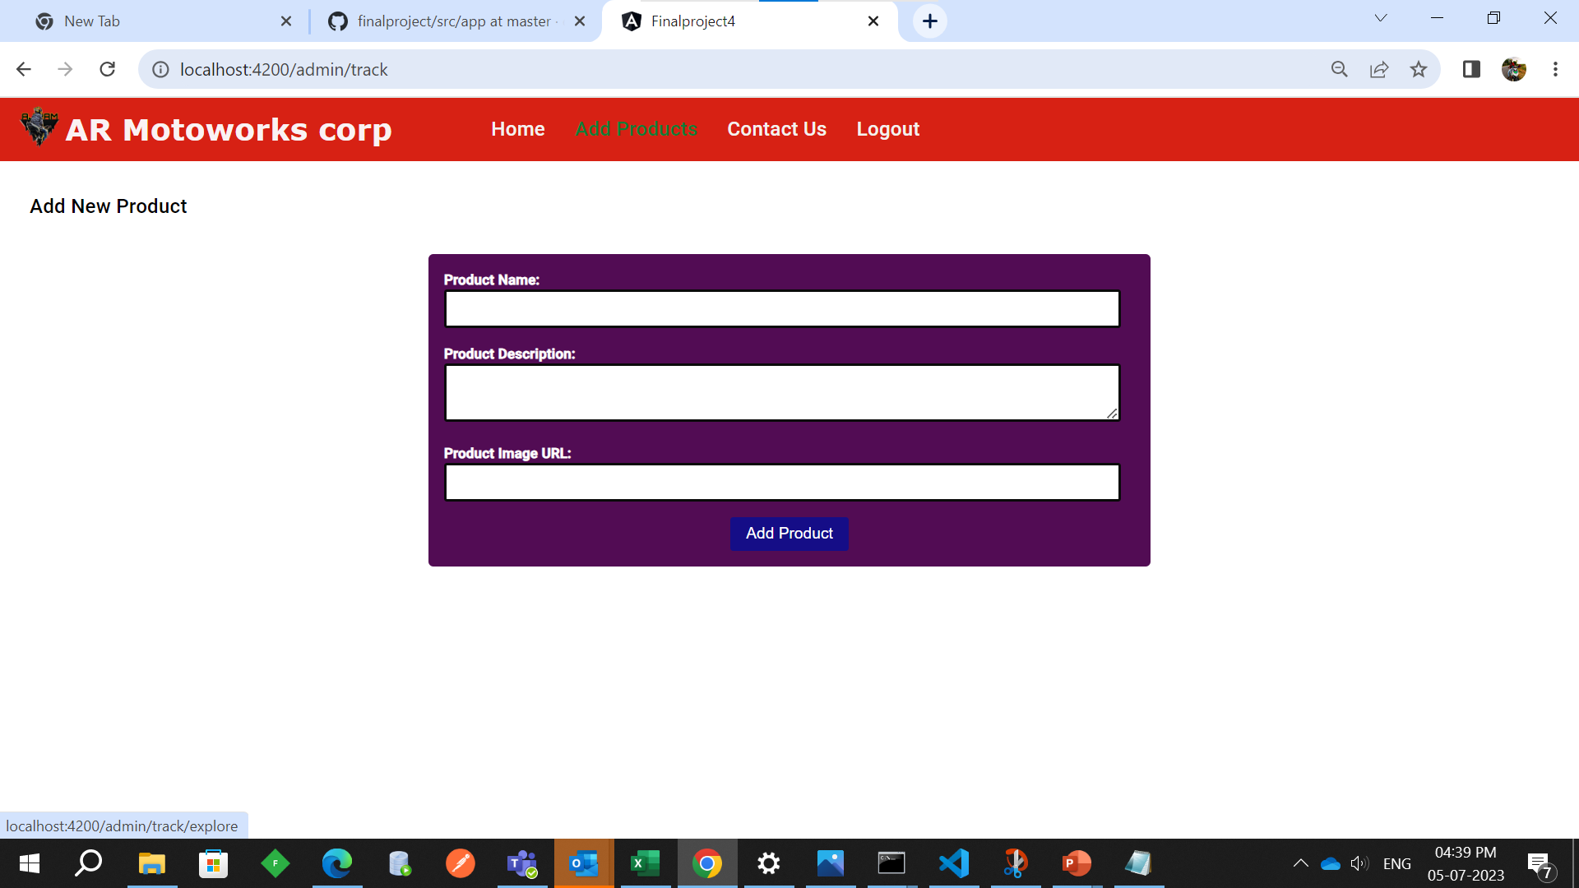
Add product

Slide 20
Thank You
Ramkumar Ravi
Ramkumar.ravi@dedalus.eu

